Slide 1
SAFE ALERT
Team Name: SafetyNet Innovators
Register Nos:
RA2211032010028,RA2211032010040,RA2211032010041,RA2211032010053
Names: Asmitha,Maneesh,Hemanth,Yaffin
Dept of Networking and Communications
School of Computing
21CSE292P- Artificial Intelligence of Things
Application Prototype
Mentor: Dr.Vaishnavi Moorthy/Asst Prof-Dept of NWC

Slide 2

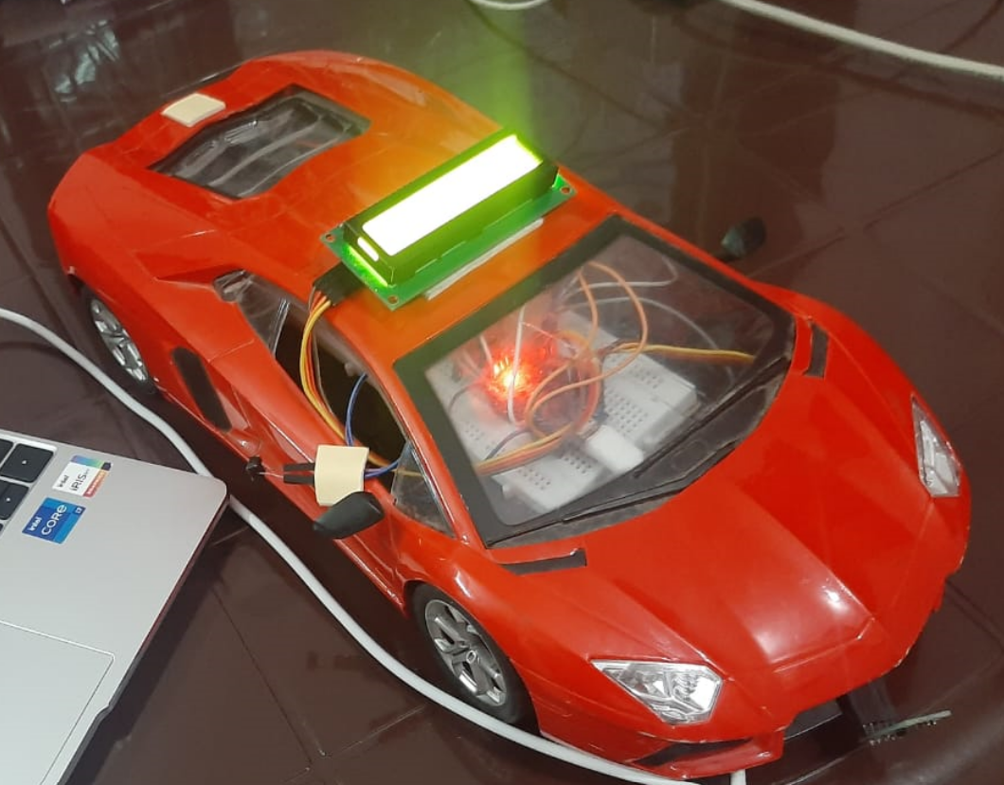
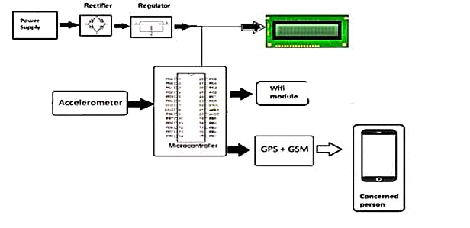

Problem statement :
IoT ecosystem
Application: Real-time Accident Alert System using GPS/GSM.
Smartness: Automated accident detection with quick alerts.
Target Users: Vehicle occupants and emergency responders.
Novelty: Integrates GPS/GSM for precise tracking and communication.
AI Technique: Uses ML for predictive analysis and proactive safety.
Key features
GPS Module: Tracks vehicle location in real-time.
GSM Module: Sends immediate alerts to emergency contacts.
Accelerometer Sensor: Detects impacts for accident alerts.
Microcontroller: Processes data and triggers swift responses.
Fig. 1: HD quality pic of the prototype
Fig. 2: System Design of proposed idea with AI
System Design
Arduino Nano for Data Capture and Processing
GSM (Global System for Mobile Communications) for Communication
GPS (Global Positioning System) for Location Tracking
ADXL335 Accelerometer for Motion Sensing
Design Cost
Arduino Nano: Rs 377
GSM module: Rs 332
GPS module: Rs 497
ADXL 335 Sensor: Rs 875
LCD I2C : Rs 469
Challenges
Integration: Ensuring smooth communication.
Power: Efficient consumption for extended operation.
Sensor: Ensuring accurate data for reliability.
Data: Real-time processing for timely alerts.
Environment: Considering factors like weather.
Reliability: Ensuring consistent performance.
Future Enhancement
Real-time Vehicle-to-Vehicle Communication for Enhanced Collision Avoidance.
Incorporation of Autonomous Emergency Braking Systems for Rapid Response.
Cloud-based Data Analytics for Comprehensive Accident Analysis and Reporting.
We can contact our department for IPR and an inhouse project were we can implement it on a more wider scale and take exact real time input for checking the model efficiency .

Slide 3
Literature Survey
Sl.No | Journal | Application/model name | Features | Shortcomings
1 | ‘Automated Vehicle Accident Alert System using IoT’ Publisher: IEEE Authors: P. Sugantha Priyadharshini; Agnes Liyana Hepzibha B; (2023) | Vehicle Accident Alert | Emergency services, Sensor systems, Sensors, Time factors, Smart phones, Accidents, Global Positioning System | Advanced Accident Detection, IoT Integration, User Feedback and Usability Studies
2 | ‘Deep Learning-based Auto Accident Detection and Alert System for Vehicles’ Authors:Misbah A; Shanid Malayil; Murshida. K.P; Mohammed Binshad; Mohammed Rizvin K.V; Mishal Kandanath Publisher: IEEE (2023) | Auto Accident Detection | Road Transportation Technological Innovation Sensitivity | REPORTING SYSTEM
3 | ‘Smart Accident Detection And Alert System’ Authors: kalki david Publisher: IEEE (2021) | Smart Accident Detection | Road accidents, Conferences, Emergency services, Automobiles, Time factors, Public healthcare | GPS Tracking
4 | ‘Accident Alert and Ambulance Tracking System’ Publisher: IEEE Authors: S. Sasipriya; Arfana Suraiba R; Ajaai R; Harini S (2021) | Accident Alert and Ambulance Tracking | Law enforcement Web services Web pages Real-time systems Mobile applications Delays | Auto tracking
5 | ‘Arduino Based Vehicle Accident Alert System Using GPS, GSM and MEMS Accelerometer’ Publisher: IEEE Authors: Pachipala Yellamma; N S N S P Chandra; Puli Sukhesh (2021) | Arduino Based Vehicle Accident Alert System | Micromechanical devices, GSM, Accelerometers, Organizations, Wounds, Modems, Liquid crystal displays | An web application for Easy management

Slide 4
Literature Survey (Contd..)
Sl.No | Journal | Application/model name | Features | Shortcomings
6 | ‘IoT Based Accident Detection And Tracking System With Telegram and SMS Notifications’ Publisher: IEEE Authors: Sharifah Nadiyah Razali; Khyrina Airin Fariza Abu Samah; (2021) | IoT Based Accident Detection And Tracking | GSM Technological innovation Road accidents Protocols Law enforcement Motorcycles Real-time systems | Insurance notifications too
7 | ‘Accident Alert System Application Using a Privacy-Preserving Blockchain-Based Incentive Mechanism’ Publisher: IEEE Authors: G. Suriya Praba Devi; J. C. Miraclin Joyce Pamila (2019) | Alert System Application | Accidents Blockchain Mobile applications Emergency services Privacy Transportation Smart phones | An Blynk based application
8 | ‘Intelligent accident detection and alert system for emergency medical assistance’ Publisher: IEEE Authors: Nicky Kattukkaran; Arun George; T.P. Mithun Haridas (2019) | Intelligent accident | Heart beat Accidents Smart phones Bluetooth Accelerometers Sensors Microcontrollers | Real time monitoring system
9 | ‘Automatic road accident detection techniques’ Publisher: Research Gate Authors: Usman Khalil (2019) | Road accident system | Vehicular ad-hoc network GSM GPS tracking | Detection based on ABEONA algorithm
10 | ‘Real time traffic accident detection system using wireless sensor network’ Publisher: SoCPaR Authors: H. M. Sherif, M. A. Shedid and S. A. Senbel (2018) | Real time traffic accident detection | Accidents Radiofrequency identification Radio frequency Real Time Traffic Accident Detection System (RTTADS) Wireless Sensor Network (WSN) | Accident Detection using RFID

